Slide 1
Spring Core

Slide 2
Topics Covered
What is Spring Bean?
Bean Properties and Scopes
Bean Life Cycle
Dependency Injection
Java Based configuration and Annotation based Configuration.

Slide 3
Spring Framework
Spring is a lightweight framework. It can be thought of as a framework of frameworks because it provides support to various frameworks such as Struts, JSF etc.
The Spring framework comprises several modules such as IOC, AOP, DAO, Context, ORM, WEB MVC etc.

Slide 4
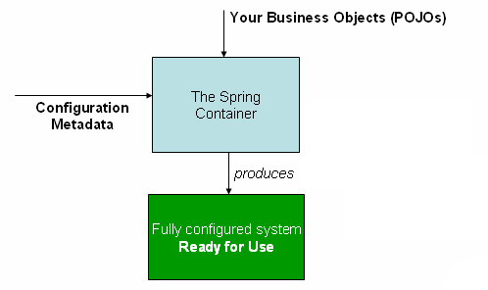
Spring Container
The Spring container is at the core of the Spring Framework. The container will create the objects, wire them together, configure them, and manage their complete life cycle from creation till destruction. The Spring container uses DI to manage the components that make up an application.
The container gets its instructions on what objects to instantiate, configure, and assemble by reading the configuration metadata provided. The configuration metadata can be represented either by XML, Java annotations, or Java code

Slide 5
Spring Bean Definition
The objects that form the backbone of our application and that are managed by the Spring IoC container are called beans.
A bean is an object that is instantiated, assembled, and otherwise managed by a Spring IoC container.
These beans are created with the configuration metadata that you supply to the container,

Slide 6
Properties of beans
 | This attribute is mandatory and specify the bean class to be used to create the bean.
Class:
Name: | This attribute specifies the bean identifier uniquely. In XML-based configuration metadata, you use the id and/or name attributes to specify the bean identifier(s).
Scope: | This attribute specifies the scope of the objects created from a particular bean definition
Constructor-arg: | This is used to inject the dependencies
Properties: | This is used to inject the dependencies

Slide 7
Autowiring mode: | This is used to inject the dependencies
lazy-initialization mode: | A lazy-initialized bean tells the IoC container to create a bean instance when it is first requested, rather than at startup.
Initialization method: | A callback to be called just after all necessary properties on the bean have been set by the container.
Destruction method | A callback to be used when the container containing the bean is destroyed.

Slide 8
Spring Bean Scopes
Singleton: | This scopes the bean definition to a single instance per Spring IoC container (default).
Prototype: | This scopes a single bean definition to have any number of object instances.
Request: | This scopes a bean definition to an HTTP request.
Session: | This scopes a bean definition to an HTTP session.

Slide 9

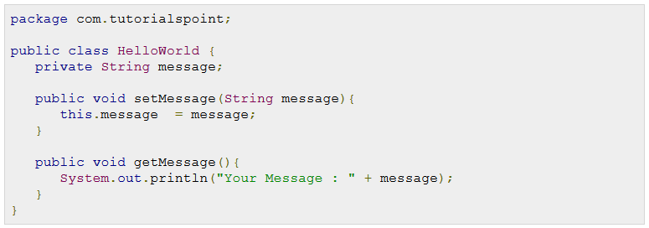
The singleton scope

Slide 10
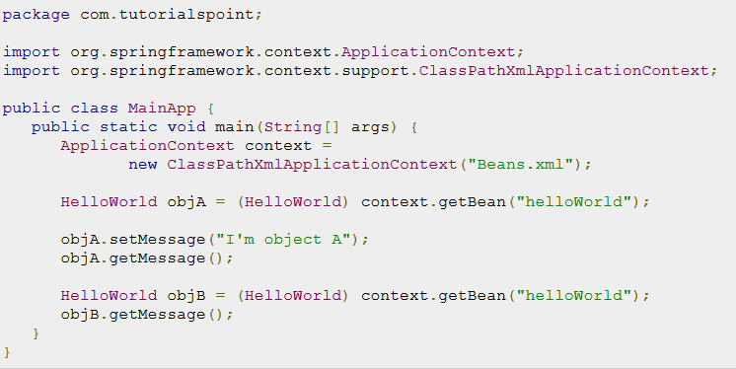



Slide 11
Init, destroy method
The life cycle of a Spring bean is easy to understand. When a bean is instantiated, it may be required to perform some initialization to get it into a usable state.
To define setup and teardown for a bean, we simply declare the <bean> with init-method and/or destroy-method parameters.

Slide 12
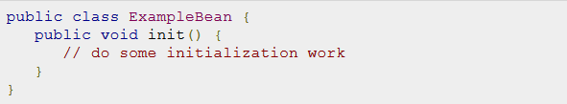
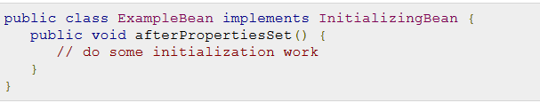

Slide 13
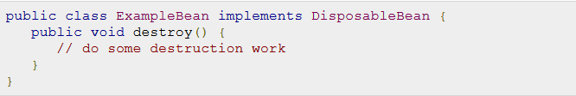
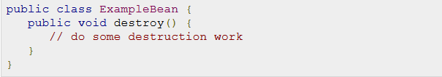
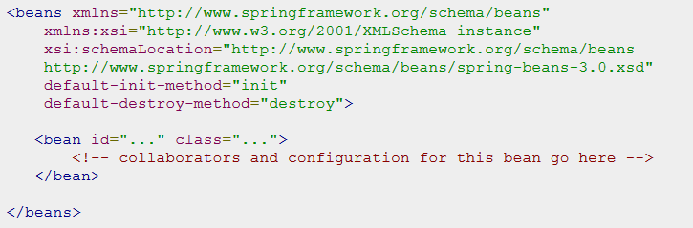

Slide 14
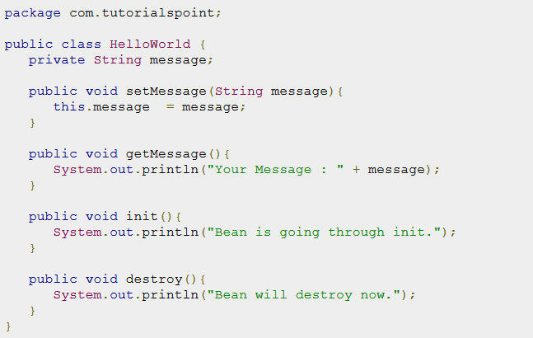

Slide 15
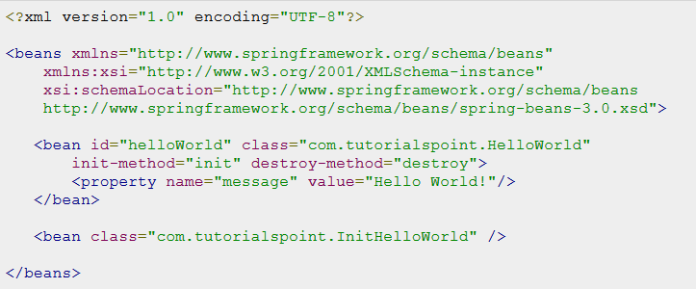
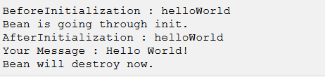

Slide 16
Spring Dependency Injection
Every java based application has a few objects that work together to present what the end-user sees as a working application.
Dependency Injection (or sometime called wiring) helps in gluing these classes together and same time keeping them independent.

Slide 17
Constructor Injection | The constructor arguments are injected during instance instantiation.
Setter Injection | This is the most favoured method of dependency injection in Spring. Dependencies are “set” in the objects through setter methods defined in a Spring configuration file.

Slide 18
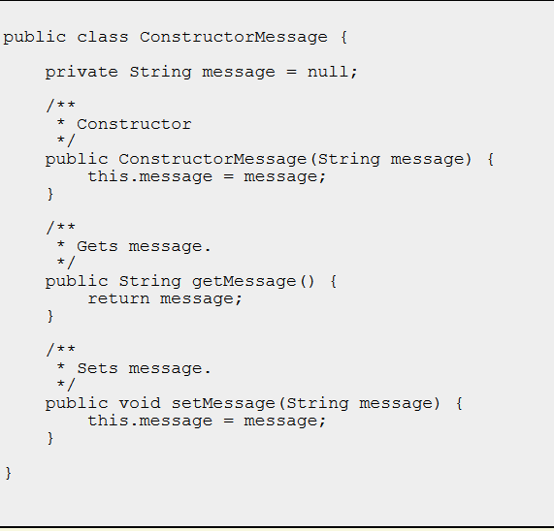

Slide 19


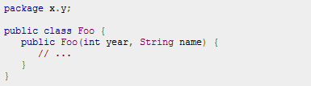
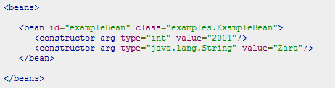
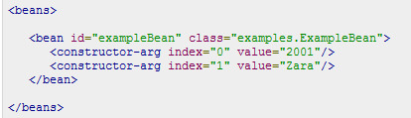

Slide 20
Spring Beans Auto-Wiring
The Spring container can autowire relationships between collaborating beans without using <constructor-arg> and <property> elements which helps cut down on the amount of XML configuration you write for a big Spring based application.

Slide 21
Mode | Description
no | This is default setting which means no autowiring and you should use explicit bean reference for wiring. You have nothing to do special for this wiring.
byName | Autowiring by property name. Spring container looks at the properties of the beans on which autowire attribute is set to byName in the XML configuration file. It then tries to match and wire its properties with the beans defined by the same names in the configuration file.
byType | Autowiring by property datatype. Spring container looks at the properties of the beans on which autowire attribute is set to byType in the XML configuration file. It then tries to match and wire a property if its type matches with exactly one of the beans name in configuration file. If more than one such beans exists, a fatal exception is thrown.
constructor | Similar to byType, but type applies to constructor arguments. If there is not exactly one bean of the constructor argument type in the container, a fatal error is raised.
autodetect | Spring first tries to wire using autowire by constructor, if it does not work, Spring tries to autowire by byType.

Slide 22
Spring Annotation Based Configuration
Starting from Spring 2.5 it became possible to configure the dependency injection using annotations. So instead of using XML to describe a bean wiring, you can move the bean configuration into the component class itself by using annotations on the relevant class, method, or field declaration.
Annotation injection is performed before XML injection, thus the latter configuration will override the former for properties wired through both approaches.

Slide 23
Annotation wiring is not turned on in the Spring container by default. So, before we can use annotation-based wiring, we will need to enable it in our Spring configuration file.
<context:annotation-config/>
Once <context:annotation-config/> is configured, you can start annotating your code to indicate that Spring should automatically wire values into properties, methods, and constructors.
S.N. | Annotation & Description
1 | @Required The @Required annotation applies to bean property setter methods.
2 | @Autowired The @Autowired annotation can apply to bean property setter methods, non-setter methods, constructor and properties.
3 | @Qualifier The @Qualifier annotation along with @Autowired can be used to remove the confusion by specifying which exact bean will be wired.

Slide 24
<context:annotation-config> is used to activate annotations in beans already registered in the application context.
<context:component-scan> can also do what <context:annotation-config> does but <context:component-scan> also scans packages to find and register beans within the application context.

Slide 25
Spring Java Based Configuration
Annotating a class with the @Configuration indicates that the class can be used by the Spring IoC container as a source of bean definitions. The @Bean annotation tells Spring that a method annotated with @Bean will return an object that should be registered as a bean in the Spring application context.

Slide 26
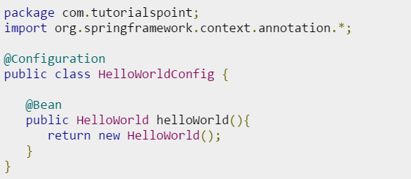
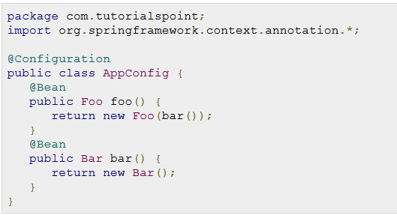
Construction
Injection

Slide 27
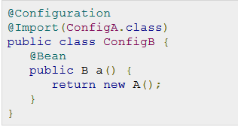
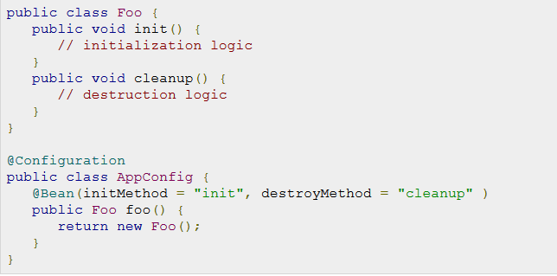

Slide 28
